Slide 1


Slide 2
Social Environmental Impacts of Mining with special reference to Rehabilitation & Resettlement

Slide 3
Introduction
Society
Ecology
Air
Water
Noise

Slide 4
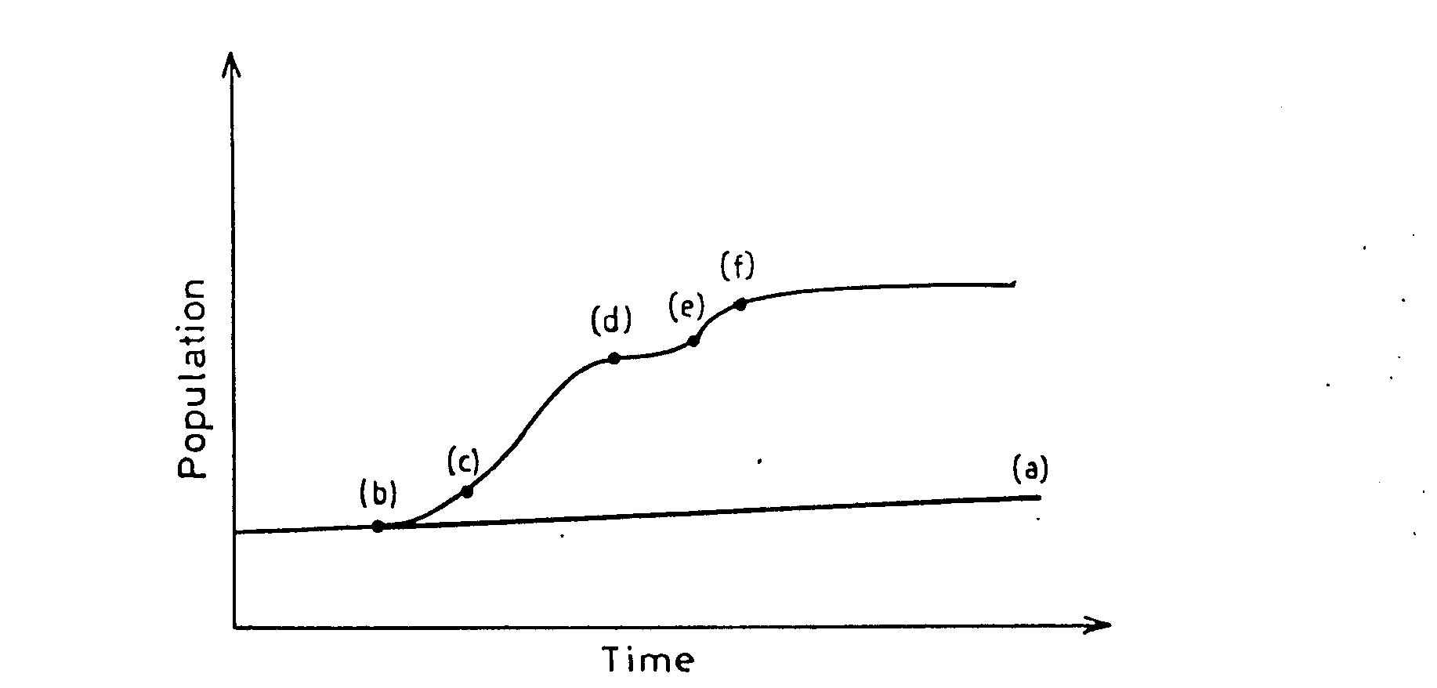
Social Impacts
Normal population growth
b) Increase in population in anticipation of economic activities with discovery of mineral
c) Population increase due to mining project coming to the planned stage
d) Population settlement due to mining project coming to the planned stage
e) The families of the employees and other persons start coming for settling
f) Normal population growth with the mining activities
Population

Slide 5
Cultural changes
Societal complexion
Sex ratio
Civic Facilities
Education
Increased cost of living
Transportation and communication
Medical facilities
Recreation
Addiction
Aspirations

Slide 6
Income pattern
Income pattern in two coal mining complexes
-----------------------------------------------------------------------------------------------------------
Sl.no. Monthly Income % of families at
(Rs.) West Bokaro Bhowra
-----------------------------------------------------------------------------------------------------------
1 < 1000 11 8
2 1000 – 4000 57 52
4000 – 6000 26 27
> 6000 6 13

Slide 7
Employment
Health problem
Inter relationship
Loss of various immovable items
Loss of non – economic assets
For rural – Lost of fishing waters, irrigation works, standing crops, trees.
For urban settlements – Loss of assets disruption of commercial ties with the customers, suppliers and distributors can cause special problem for traders, small business, street vendor’s cottage industries etc.
For very poor – Loss of assets or opportunities could include collection of roots, berries or leaves for sale or dietary supplement occasional portage.

Slide 8
Resettlement Plan
Above points clears the damage to host population by Mining. To minimize this type of affects proper rehabilitation and resettlement policy is needed. The underlying principle of rehabilitation and resettlement/ settlement is to improve, or at least restore the social and economics well being of the displaced population. This will entail rendering technical and financial assistance to the displaced persons/families to enable them to rebuild (a) their lives (b) their self sustaining economic basis. Both the people displaced and the managers of resettlement will face extra ordinary difficulties, particularly because the starting point of resettlement is the setback caused by the loss of key productive assets. Resettlement plan should be an integral part of the project plan. Where large number of people are to be moved, such as entire communities, a more detailed plan is required than when only few people are to be located. For success, resettlement planning and implementation requires close appreciation of the essential needs of the settlers. Those responsible for planning the resettlement need to think about the economic and cultural. Characteristics of the population to be moved and how these will affect its response to relocation and its ability to cope in the new environment it is desirable to have the advice of professional sociologists, especially when dealing with isolated or culturally non‑homogeneous populations, or with particularly vulnerable groups, etc. (for example, ethnic minorities, or women headed household etc.). Planning for Resettlement should begin as early as possible

Slide 9
1. The Restoration/Improvement of the productive base and the income earning ability
The curx lies in ensuring that the productive base and the income earning ability of involuntarily resettled are improved. They should also (a) share the benefits of the new development and (b) should be compensated for the transitional hardships. The idea is to help the affected people to attain the standards they would have attained/achieved if they were not displaced

Slide 10
2. Development ‑ oriented resettlement
Development- oriented resettlement calls for a change in approach. Planning and design should incorporate that the development of social infrastructure such as schools and the health services , the access to employment opportunities, the allotment of housing plot and devilling should cater to the needs of those likely to the resettled. It should be kept in view that their family will grow and provision should be made to take into consideration at least the first and second generation.
Similar approach should apply to the infrastructural systems comprising of feeder roads and water supply, or service systems like marketing networks and agricultural extension. Future expansions should be in‑built. The process of resettlement is facilitated when those displaced are allowed to share in the benefits of the new developments. For example, being resettled in the newly irrigable areas downstream, whereas possible, or by getting access to a share of the new power capacities or revenues. Etc. Following five points must be taken into consideration before planning of any R&R policy

Slide 11
3. The social economic and cultural integration of the resettlers with the host population
It is a slow process but an indispensable process, if viable communities, settlements and new social networks are to be rebuilt. Such a process can be accelerated by proper planning that integrates host settler development. Equitable treatment should be accorded as far as possible to both hosts and settlers. If possible, education, water, health and other services should be made available to both the groups, on equitable basis.
A suitable social climate needs to be generated for their integration. Any payment due to the hosts for land or other assets, provided to settlers, should be promptly made as this will promote the development of desired climate.

Slide 12
4. Resettlers Participation
This will improve the understanding of their
needs,
resources and preferences
prevent costly mistakes
help reduce the understandable reluctance to move and stress associated with the dislocation, and
accelerate the subsequent transition to and integration within the new settlements.
There should be dissemination of information about the relocation, and the following need be known to those affected by displacement.
Resettler’s rights
Compensation procedures
Available choices
etc,

Slide 13
The lack of accurate information causes misunderstanding and develops resistance. A program to inform and educate is therefore a prerequisite for obtaining the co-operation of the affected population.
Involving the local leadership and the non-governmental organisations (NGO’s) is another basic requirement.
NGO’s are apt to articulate resettler’s needs and defend their entitlements
Traditional local organisations and the ethnic and religious leaders are usually respected by the people.
Planners and administrators should seek their involvement in planning relocation wherever possible , in order to
Facilitate communication
Mobilisation of group resources and co-operation
The various socio-cultural factors should be taken into account in planning and implementation resettlement.

Slide 14
Base line information and studies required for planning
(A) Information on area to be evacuated
1. Census of population to be displaced demographic indicators with key demographic indicators
Density Growth rate
Pattern Caste wise
Sex-ratio Age wise
Family size Social distinctions
Migration Life expectance
Child mortality rate­
Aspirations

Slide 15
2. Inventory of property to be lost and their valuation
Irrigated land
Non‑irrigated land
Houses
Wells
Trees
Cattle, etc.
3. Description of production systems existing in the area
4. The main social and ethnic groups
Farmers
Landless laborers
Tribal groups
Artisans‑craftsman
Transporter
Manufacturer etc.

Slide 16
5. Forms of social organisation that operate
Ownership tenure system Kin groups or extended family systems, etc.
6. Description of various groups at higher risk, particularly of the women headed households, the elderly, the handicapped etc.
7. Determination of major income sources.
8. Inventory / Description of public or common areas, infrastructure and other productive or social resources, shared or divided.
village school
temples
health rooms
shared grazing lands
access to adjoining forest

Slide 17
(B) Information and design for relocation sites
1.Identification of the new settlement sites ‑ whether consolidated new settlement or fill ‑ In operations
2.Survey of host population at / around new settlement; areas and their resource wise pattern.
Attention to economic, demographic, ecological, ethnic or other features that limit respectability to displaced population
Estimate carrying capacity of existing resources
Potential for intensification
3. Feasibility studies, including assessment of new site suitability
Adequate water resources, soil capability, grazing lands, fuel wood resources and others that are common.
Suitability of residential sites
Site preparation requirements charromg, leveling, tree planning, etc.
Assessment of required new infrastructure.

Slide 18
Tenets of Resettlement Plan
Development Packages and Strategies:
Development package
Two basic strategies
Land based
Non land based
Combination
Providing economic opportunities to re‑establish the displaced populations are agricultural producers, rural artisans etc. is the curx of any viable resettlement.
Technically feasible agricultural production package are likely to be the main channel of restoring the production systems of displaced persons from the rural areas.
Economic opportunities can be provided by building into the agricultural redevelopment packages specific project‑funded activities such as :
land reclamation agricultural intensification
tree crops development vocational training
fisheries commercial or social forestry irrigation schemes
other kinds of income generating activities off farm employment

Slide 19
Provision of land bank may be a fruitful step.
Even when land is available, non ‑land‑based strategies may be needed for some displaced persons.
In situations of extreme Land scarcity, non‑land based strategy become imperative.
Opportunities then need to be opened in the industrial or service sectors of the local or those of the region.
Job creation through new investments in called for, because vocational training alone, without actual provision of employment to those displaced, does not restore income.
When urban settlements are involved , the resettlement plan must give attention to the complexities of
site ownership
legality of site occupation
site related economic (productive or service ) activities
Planned provisions to ensure that services will be capable of handling the needs of the displaced are also, a critical part of the resettlement plan.

Slide 20
2. Compensation: Difficulties associated with cash compensation.
It is usually not adequate
3. Habitat
Housing at the new site Sanitary facilities
Drinking water supply systems Schools
Health care facilities Parks
Better infrastructure and housing standards than what they were enjoying prior to dislocation. The following, for example, is provided in NCL resettlement townships:
1. Roads 2. Drains
3. Hand pumps 4. Wells
5. School 6. Health centre
7. Shopping centre 8. Panch bhawan,
9. Play ground 10. Street lighting
11. Children park 12. Plantation

Slide 21
4. Social Organisation of Resettlers
Social and cultural institutions of those displaced should be supported and used as much as possible. Their own initiative should be encouraged through self, help & incentive program.
b) Many anthropological and sociological analysis or settlements schemes indicate the positive role of own organisation & self management of those displaced:
A gradual transfer of responsibility from the managers of resettlement to those displaced and resettled.
Action should be taken from the outset to prepare for the transfer of the responsibilities or management to the displaced / resettled persons.
The emergence of recognised community leaders be encouraged.
This will increase participation stimulate local initiative, and greatly facilitate the task resettlement.
The preference of the majority from among displaced to move in groups as cultural / social units (e.g. as entire kin group, extended firmly, ethnic group, whole village unit etc.) should be encouraged. Such group movement has the potential to get socially organised and economically productive at the new location early.
Such arrangement for resettlement as cultural units would protect an important social resource ‑ the viable patterns of group organisation ‑ which can act immediately at the new location to caushion disruption caused by resettlement.

Slide 22
ENVIRONMENTAL MANAGEMENT
The resettlement plan must be drawn with a definite orientation towards preventing environmental deterioration as aconsequences not only of the main project but also of resettlement as such:
The key indicator could be the ratio between the incoming resettlement population and the host population already inhabiting the receiving areas. This would measure the incremental population density per unit of land caused by resettlement and the likely increased pressure on the area's natural resources.
If the projected consequences on the physical environment are unacceptable, alternative resettlement sites must be found

Slide 23
Conclusion
In a nutshell a well balanced resettlement plan incorporating
production based development packages,
adequate compensation,
provisions for habitat and new settlement, infrastructure,
health & environmental protection measures,
as well as the strengthening of social organisation and local institution will initiative a positive response from those who are affected by displacement.
The coal India has realized that the major challenges for implementation of their new policy and taken several steps and start several programs in this direction.

Slide 24
Reference
Training modules, Training of Environmental personnel, vol.-2, set – 1, Indian school of mines, Dhanbad.
Coal sector impact assessment of the Indian coal Sector : A CIL Report
Resettlement and Rehabilitation Policy of coal India, April 1994.
Census Report of Dhanbad district.
Saxena N.C., Environmental aspect of mining industry, under press.
Personnel experience of retd. C.G.M, A. S. Prasad Mahanadi coalfields ltd., incorporated during his tenure as a professor (as Rajeev Gandhi chair post) in Indian school of mines.

Slide 25
THANKS

